Slide 2
WELCOME TO MEDIATION NETWORK!

Slide 3
FACTS ABOUT THE PROJECT
ERASMUS+ Strategic partnership project
Duration: September 2016 – April 2019

Slide 4
6 PROJECT PARTNERS
Turiba University (Latvia)
University of Genoa (Italy)
Mykolas Romeris University (Lithuania)
University of National and World Economy (Bulgaria)
University of Graz (Austria)
University of Economics, Prague (Czech Republic)

Slide 5
MAIN AIM OF THE PROJECT
The aim of this project was to create and integrate in the curriculum of the partnering universities and to offer to any University or mediation training institution an online education platform seeking to digitalize the teaching process.

Slide 6
ACTIVITIES
Analyzing existing study and teaching materials in mediation field;
Organizing discussion and round-table meeting in 6 countries to encourage the discussion about the mediation and training needs;
Teachers’ training in Vilnius, February 2018;
Intensive Course for students in Riga, July 2018;

Slide 7
ACTIVITIES
Developing several study and teaching materials;
Developing mediation platform;
Developing on-line mediation training tool;
Organizing 2 international conferences in Vilnius (January 2019, joined with mediation tournament for students) and Riga (11th of April 2019);
Organizing 4 national information events in Austria, Bulgaria, Czech Republic and Italy.

Slide 8
MAIN RESULTS
You will find all materials and products in web-platform
http://mediation.turiba.lv

Slide 9
INFORMATION ABOUT MEDIATION
General information about mediation
Mediation Laws in 6 partner countries
Mediation organizations in 6 countries
Information about admission of mediators in 6 countries

Slide 10
STUDY MATERIALS
Variety of materials for STUDENTS
Variety of materials for TEACHERS

Slide 11
BEST PRACTICE MANUAL AND METHODOLOGY
Variety of materials for TEACHERS

Slide 12
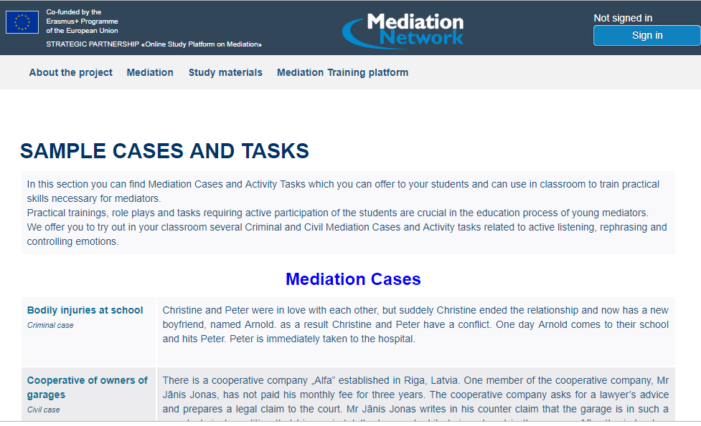
SAMPLE CASES
Variety of materials for TEACHERS

Slide 13
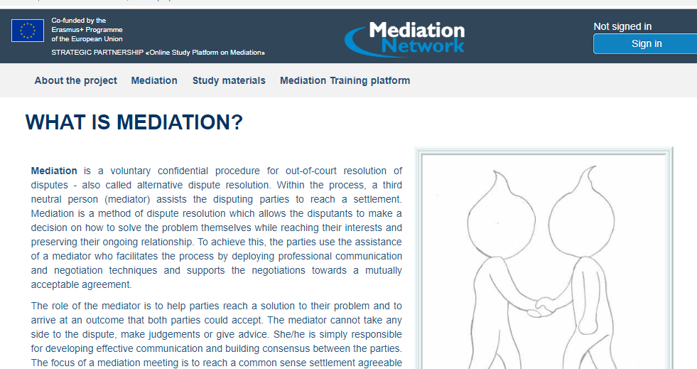
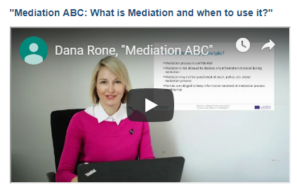
FOR STUDENTS
Variety of materials for STUDENTS
MEDIATION ABC
ABC TEST
VIDEO LESSONS
TRAINING VIDEOS
E-BOOK ON MEDIATION

Slide 14
FOR STUDENTS

Slide 15
FOR STUDENTS

Slide 17
ON-LINE TOOL
FOR STUDENTS TO TRAIN ON-LINE MEDIATION SKILLS
TOOL WILL BE OPEN IN APRIL 24th
REQUIRES REGISTRATION
CONTACT US TO BECOME THE PARTNER UNIVERSITY!

Slide 18
FOLLOW US ON:

